Slide 1

Cost of Living Report
UN - Department of Economic and Social Affairs Gianmarco Fistani / Hui Yi Huang / Jade Meneghini

Slide 2
Dataset
Cost of living is the amount of money required to maintain a certain standard of living, encompassing:
1
Restaurant
2
Market
Meals, McDonald's, Drinks
Diaries, Fruits, Meats, Vegetables, Drinks, Wines
3
Transportation
4
Utilities
Local transport tickets, Taxi, Car
Electrics, Waters, Internets
5
Sport & Leisure
6
Cloth
Gym, Tennis, Cinemas
Jeans, Dresses, Shoes
7
Accommodation
8
Financial
Renting apartments, Buying houses
Salaries, Mortgage rate

Slide 3
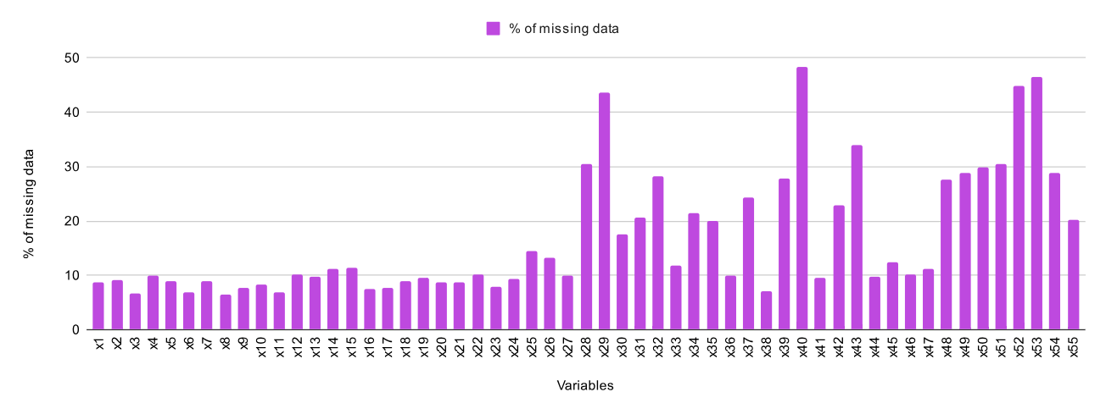
Data Cleaning
Percentage of Missing Data in Each Variable
Low-populated countries and city-states, such as Greenland or San Marino, have limited data availability.
Missing data was imputed at the lowest granularity (city) with the relative country mean.

Slide 4
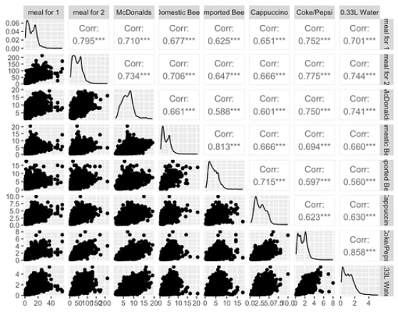
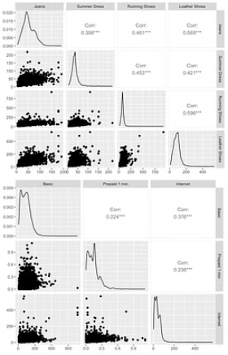
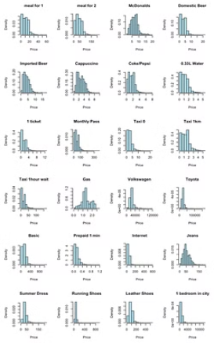
How do living costs compare globally?
With ggpairs and histgrams, most of the factors are extremely right-skewed distribution.

Slide 5
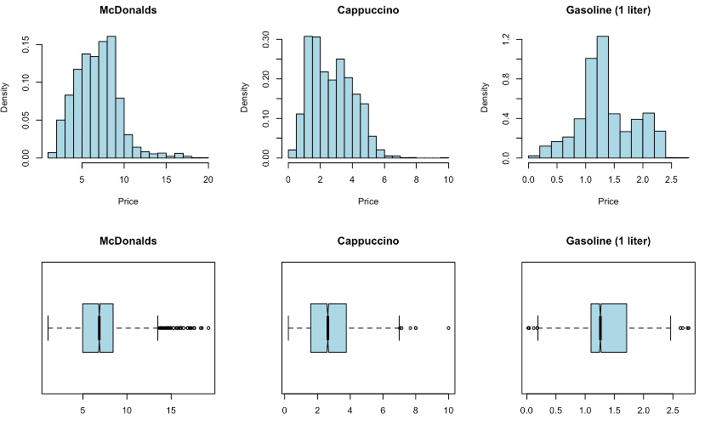
How do living costs compare globally?
Close to normal distribution :
McDonalds : Global brand with standardized products and pricing strategy.
Cappuccino & Gasoline :
Globally traded commodity produced and consumed in numerous countries worldwide.
Relatively balanced supply-demand relationship.

Slide 6
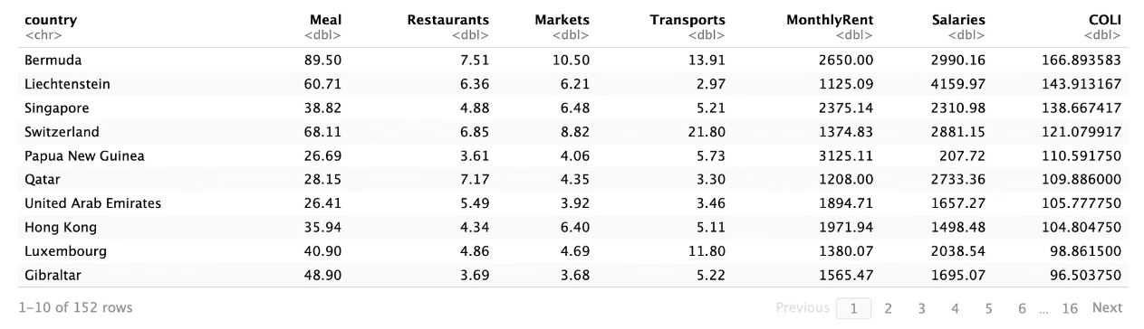
Cost of Living Index
What factors contribute to variations in the cost-of-living index (COLI) across cities?
The Cost of Living Index (COLI) is a measure designed to quantify the relative cost of living globally.
Most Important Categories:
Meal (20%)
Market goods (20%)
Monthly Rent (20%)

Slide 7
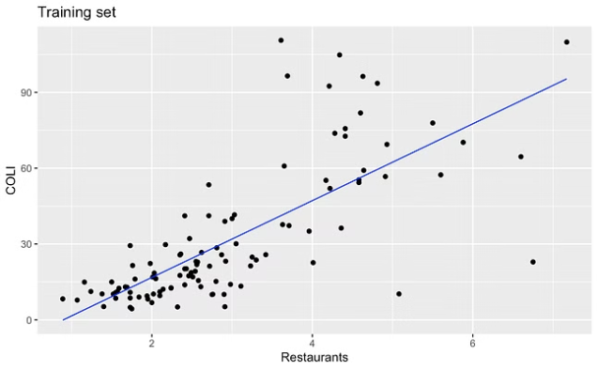
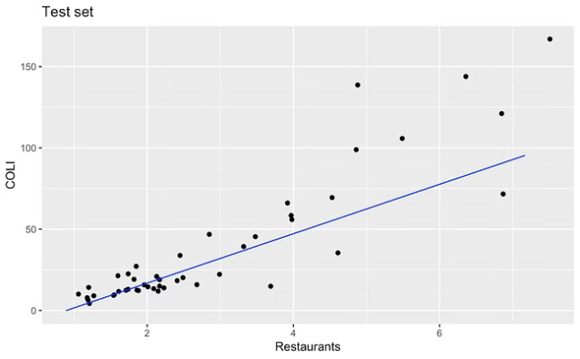
COLI and Restaurant Costs Prediction
In both charts, there is a positive correlation between COLI and cost of restaurants.
As the cost of restaurants increases, COLI also tends to increase.
60% of the COLI variation explained

Slide 8
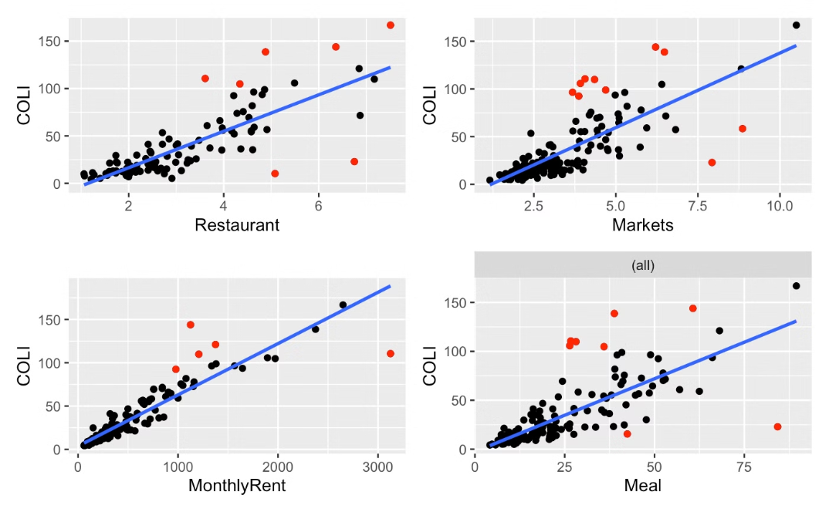
How's COLI related to basic factors?
All positive correlation (coefficient close to 1)
Outliers are acceptable (e.g local products tend to be cheaper locally)
Countries with a higher COLI tend to have higher basic factors costs (as we expected)

Slide 9
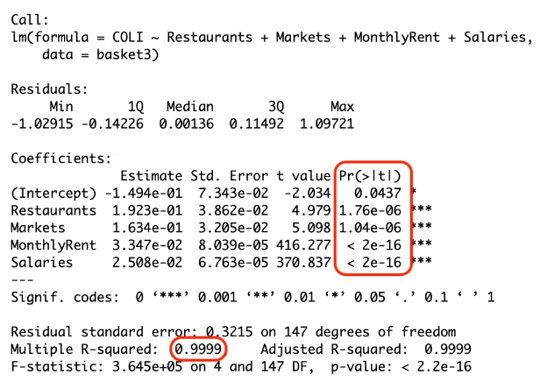
How's COLI influenced by many factors
COLI is strongly related to each factors
R-squared = 0.99
Regressors are statistical significant
P-value < 0.05
Residuals are scattered randomly around zero (1st chart)
Residuals are approximately normally distributed around the line (2st chart)

Slide 10
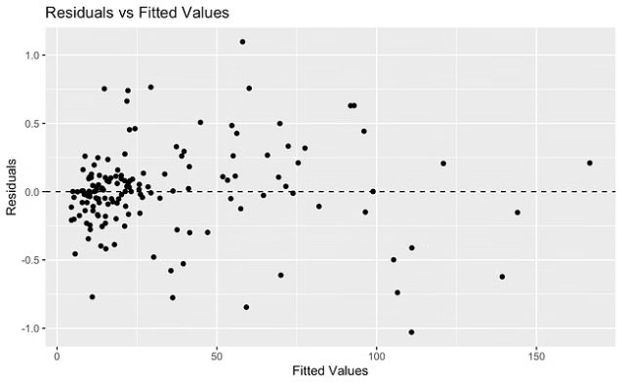
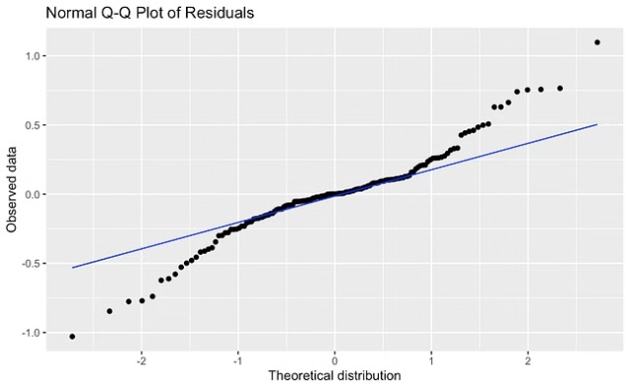
How's COLI influenced by many factors

Slide 11
What factors most affect the COLI across countries?
Costs of restaurant
Costs of market goods
Costs of monthly rent
Salary
If there are any changes in these factors, COLI will be highly impacted.
For example, by addressing these factors cities with low-coli (e.g. Sri Lanka, Syria) would immediately improve their economic growth and quality of life .

Slide 12





Salary vs Basic Cost
Assessing affordability levels for essential needs.
Includes everyday meals, transportation, utilities, and accommodations.

Slide 13
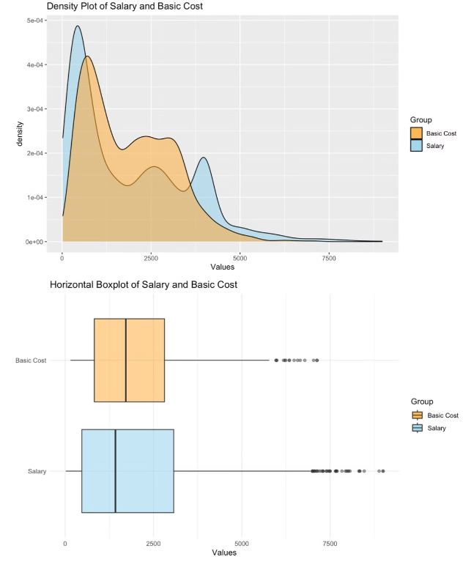
The Basic Cost compared with Salary
Range of salary is bigger than basic cost
Higher volatility in salaries across cities
Economic conditions or industry differences
Average of basic cost is higher than salary
Salary is not enough to cover basic living costs
Price levels, housing costs, inflation rates, etc.

Slide 14
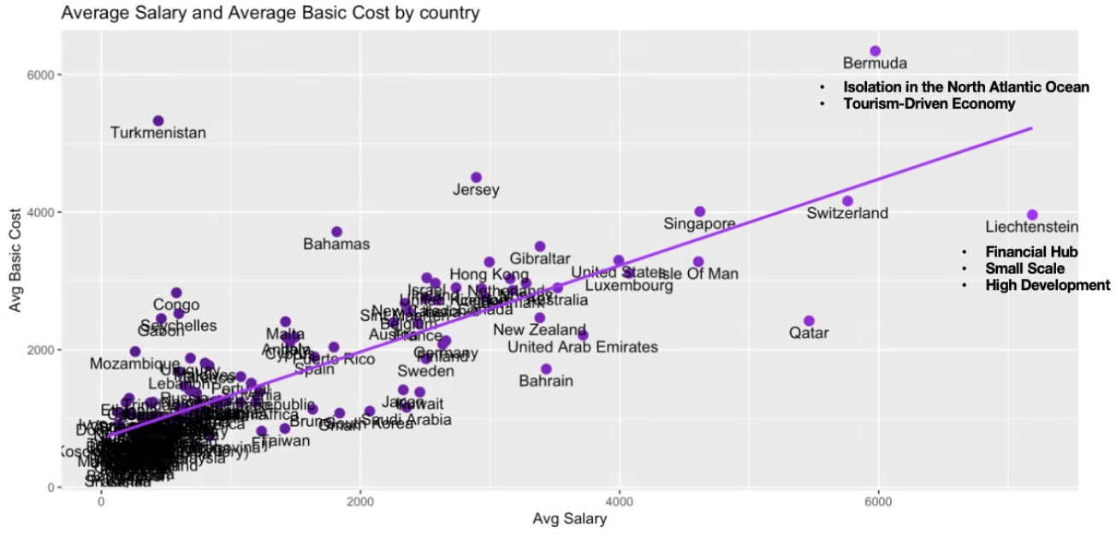
The Basic Cost compared with Salary

Slide 15
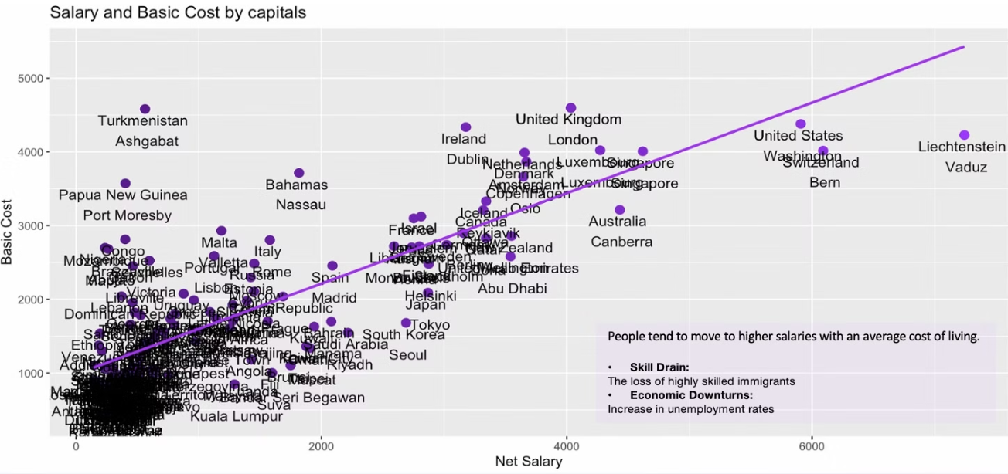
The Basic Cost compared with Salary

Slide 16
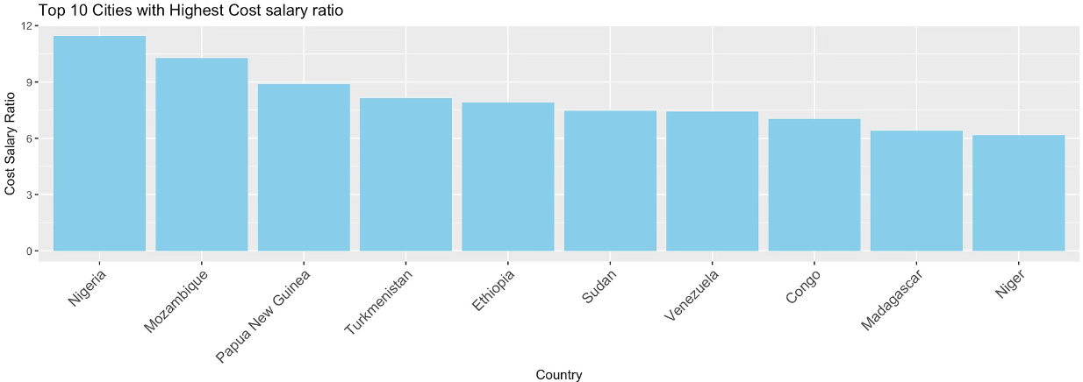
Cost Salary Ratio - Highest
In some countries, the average salary is not enough to cover basic living costs.
1
Reduce the cost
2
Increase salary level
Price controls on essential goods
Increase minimum wage
Increase supply of housing
Education and training for workers

Slide 17

Developed VS Developing Countries
Based on Country Insights | Human Development Reports (undp.org)rankings.
Very High Development
High Development
Medium Development
Low Development
vhigh data
high data
medium data
low data

Slide 18
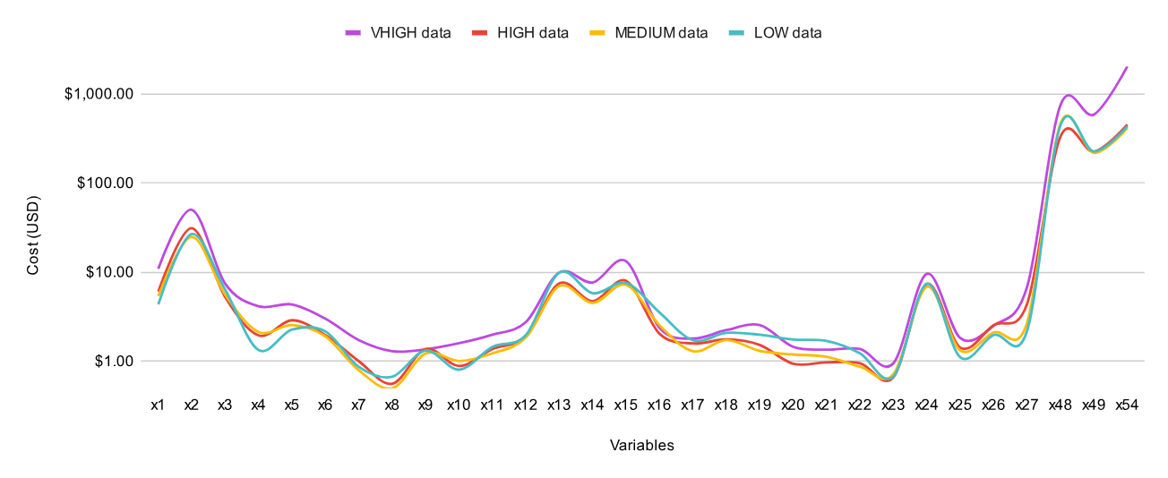
Cost of living is greater in developed countries.
Average Variable (USD) by Country Development Level
Net salaries (x54) in developed nations +4.5 times larger than closest high development countries.
Low development countries have high average net salary (x54) almost equal to medium to high development countries.

Slide 19
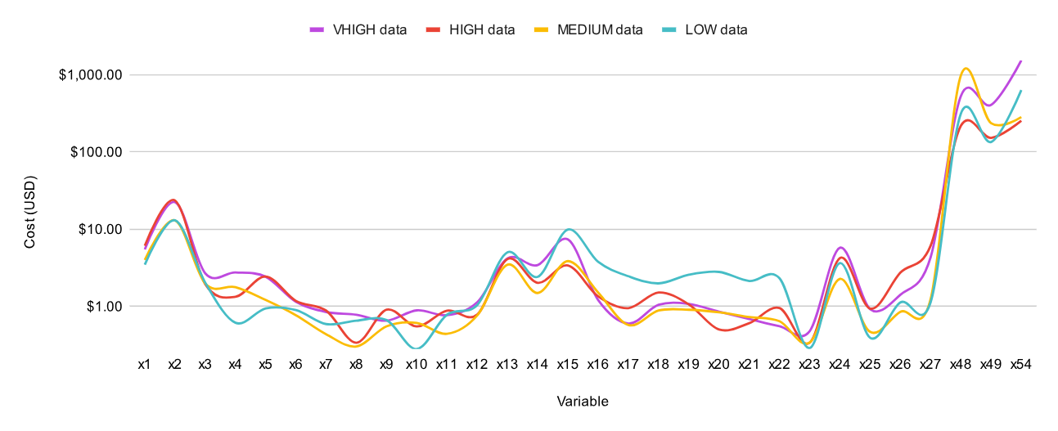
Cost of living is greater in developed countries.
Standard Deviation of Variable (USD) by Country Development Level
When comparing countries development level each variables show great variability in cost.
Net Salaries (x54) of both developed and low development countries have higher variability compared to medium to high development countries.

Slide 20
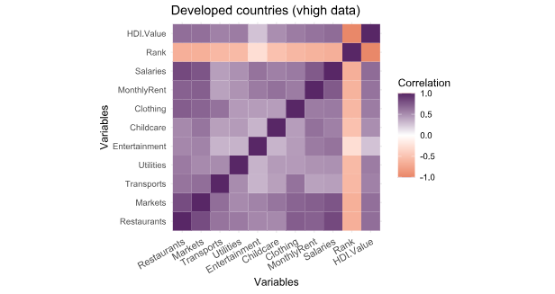
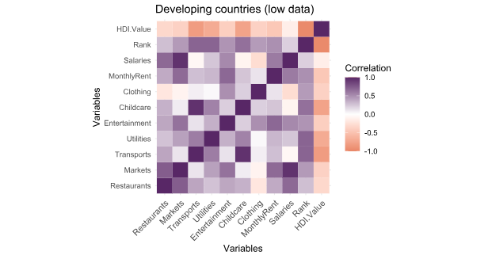
Salaries Increase Proportionally with Country Development:
Correlation of Developed Countries (vhigh) and Low Development Countries (low)

Slide 21
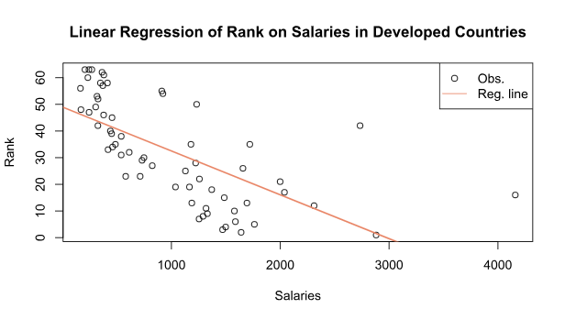
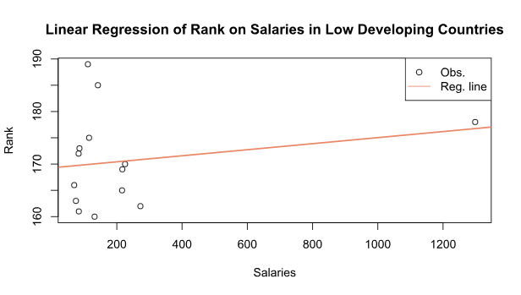
Salaries Increase Proportionally with Country Development:
In developed countries, as net salaries increase the country rank number decreases (indicating a higher country development).
In low development countries there is almost no linear relationship, highlighting that perhaps higher spending power isn't always equal to increased country development.

Slide 22


What are the main drivers of cost-of-living disparities between developed and developing nations?
There is no one overarching driver of cost-of-living disparities between developed and developing nations.
The relationship between cost-of-living and country development is complex and encompasses more than simply economic variables. To further understand the drivers of cost-of-living disparities it is necessary to look at other factors such as culture, economic structure, law and regulations, and institutional frameworks.

Slide 23
Thank you
Data sources:
Global Cost of Living (kaggle.com)
Country Insights | Human Development Reports (undp.org)
Gianmarco Fistani / Hui Yi Huang / Jade Meneghini

Slide 24
Appendix

Slide 25
Variables Description
Column Name | Description | Column Name | Description
city | Name of the city | x23 | Water (1.5 liter bottle, at the market) (USD)
country | Name of the country | x24 | Bottle of Wine (Mid-Range, at the market) (USD)
x1 | Meal, Inexpensive Restaurant (USD) | x25 | Domestic Beer (0.5 liter bottle, at the market) (USD)
x2 | Meal for 2 People, Mid-range Restaurant, Three-course (USD) | x26 | Imported Beer (0.33 liter bottle, at the market) (USD)
x3 | McMeal at McDonalds (or Equivalent Combo Meal) (USD) | x27 | Cigarettes 20 Pack (Marlboro) (USD)
x4 | Domestic Beer (0.5 liter draught, in restaurants) (USD) | x30 | Taxi Start (Normal Tariff) (USD)
x5 | Imported Beer (0.33 liter bottle, in restaurants) (USD) | x31 | Taxi 1km (Normal Tariff) (USD)
x6 | Cappuccino (regular, in restaurants) (USD) | x32 | Taxi 1hour Waiting (Normal Tariff) (USD)
x7 | Coke/Pepsi (0.33 liter bottle, in restaurants) (USD) | x33 | Gasoline (1 liter) (USD)
x8 | Water (0.33 liter bottle, in restaurants) (USD) | x34 | Volkswagen Golf 1.4 90 KW Trendline (Or Equivalent New Car) (USD)
x9 | Milk (1 liter) (USD) | x35 | Toyota Corolla Sedan 1.6l 97kW Comfort (Or Equivalent New Car) (USD)
x10 | Loaf of Fresh White Bread (500g) (USD) | x36 | Basic (Electricity, Heating, Cooling, Water, Garbage) for 85m2 Apartment (USD)
x11 | Rice (white), (1kg) (USD) | x37 | 1 min. of Prepaid Mobile Tariff Local (No Discounts or Plans) (USD)
x12 | Eggs (regular) (12) (USD) | x38 | Internet (60 Mbps or More, Unlimited Data, Cable/ADSL) (USD)
x13 | Local Cheese (1kg) (USD) | x39 | Fitness Club, Monthly Fee for 1 Adult (USD)
x14 | Chicken Fillets (1kg) (USD) | x41 | Cinema, International Release, 1 Seat (USD)
x15 | Beef Round (1kg) (or Equivalent Back Leg Red Meat) (USD) | x42 | Preschool (or Kindergarten), Full Day, Private, Monthly for 1 Child (USD)
x16 | Apples (1kg) (USD) | x44 | 1 Pair of Jeans (Levis 501 Or Similar) (USD)
x17 | Banana (1kg) (USD) | x45 | 1 Summer Dress in a Chain Store (Zara, H&M, …) (USD)
x18 | Oranges (1kg) (USD) | x46 | 1 Pair of Nike Running Shoes (Mid-Range) (USD)
x19 | Tomato (1kg) (USD) | x47 | 1 Pair of Men Leather Business Shoes (USD)
x20 | Potato (1kg) (USD) | x48 | Apartment (1 bedroom) in City Centre (USD)
x21 | Onion (1kg) (USD) | x49 | Apartment (1 bedroom) Outside of Centre (USD)
x22 | Lettuce (1 head) (USD) | x54 | Average Monthly Net Salary (After Tax) (USD)

Slide 26
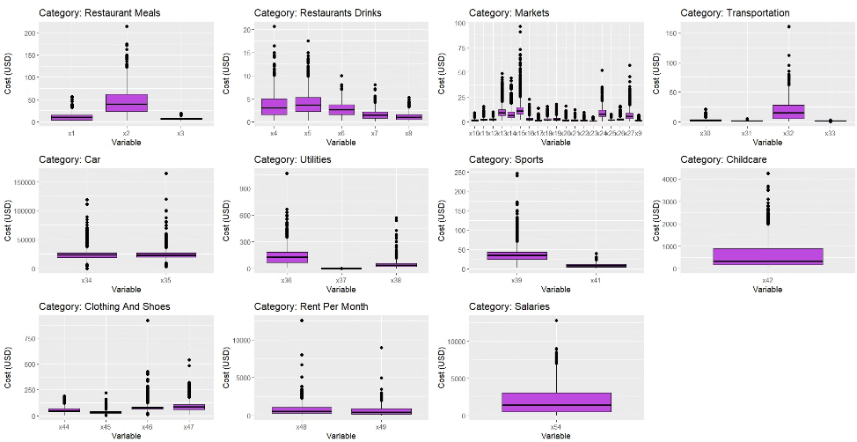
Global Cost of Living: EDA
Boxplots of Variables Grouped by Category
Switzerland's higher meal prices (x2) and market prices reflect its generally elevated cost of living.
Qatar's beer pricing (x4) likely influenced by cultural and religious factors.
High prices in fitness categories (x39, x46) may represent niche markets or specific brands.
Outliers in Iranian new car data (x34, x35) for potential inconsistencies.

Slide 27
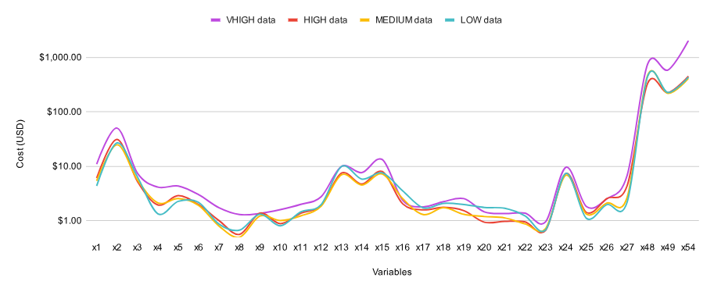
Developed VS Developing Countries
Average Variable (USD) by Country Development Level
Mean:
Fast food(x3) is $0.5 more expensive low developing nations than in medium to high development countries.
Cappuccinos and bottled water at the restaurants(x6) are cheapest in medium to high development countries.
Local cheese (x13) is expensive regardless of country development level.
The cost of fresh produce (x16 to x22) also shows interesting fluctuations but overall cost of those will depend on what and how much local agriculture produces.
Standard deviation:
Low development countries show highest variability for fresh produce (x16 to x22).
Standard deviation remains consistent across all development levels for restaurant drinks (x4 to x8)

